Slide 1
Peripherals Division
"Materials of parts stamped" standards
Rev02
17Feb2011
周辺品保センター
環境規制課

Slide 2
The judgement of parts stamp
Requirements for parts marking materials
Canon standard/Blue angel/Environmental statute
→The size of parts / 25g or more / 200m㎡ or more
The size of the characters stamped parts
“The height 3mm, width 1.5mm, spacing 0.5mm, height mark (male)
0.1 ~ 0.3mm ” was revised.
(Apply from 2009 new products)
※In parts of the subject, “Paper passing" and "function" may be excluded.
Discuss its contents in HP and Canon

Slide 3
The judgement of parts stamp
○ | OK
△ | MTphase the TD1. MP NG, modifications to the mold
× | NG. modifications to the mold
【parts stamp】
material | stamp | contents | judge | comment
ABS | ＞ABS＜ | ①No stamp ②＞ABC＜ ③＞PC+ABS＜ | × | ①Material can not be determined ②③stamp is wrong
 |  | ABS | △ | “> <“there is no marked Materials can be specific
 |  | ) ABS( | △ | “> <“there is mistook Materials can be specific
PC+ABS | ＞PC+ABS＜ | ＞PC +ABS＜ | ○ | The two line display with no problems
 |  | ①＞PC+ ABS＜ ②＞ PC+ABS ＜ | ○ | There was a blank. But materials can be specific
 |  | ①＞PC-ABS＜ ②＞PC ABS＜ | △ | Materials can be specific

Slide 4
【additive stamp】
material | stamp | contents | judge | comment
PP | ＞PP-MD30＜ | ①＞PP＜ ②＞PP-MD＜ | × | stamp is wrong
 |  | ①＞PP-MD20＜ | △ | Have the wrong number
PA66 | ＞PA66-（GF25+MD15）＜ | ＞PA66-（GF+MD）40＜ | ○ | The same meaning
 |  | ①＞PA66-（GF25+MD15）40＜ | △ | Number (40) overlap
【fire-retardant material】
material | stamp | contents | judge | comment
ABS | ＞ABS-FR(17) ＜ | ①＞ABS-FR＜ ②＞ABS-FR（40）＜ | × | stamp is wrong
 |  | ＞ABS-FR17＜ | △ | “( )“there is mistook Materials can be specific

Slide 5
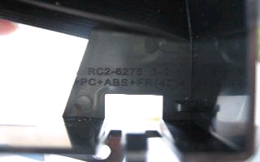
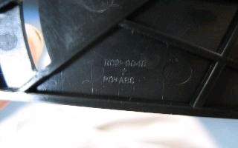
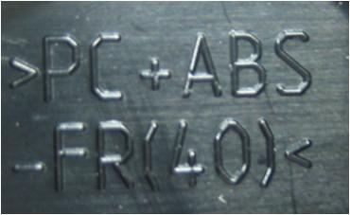
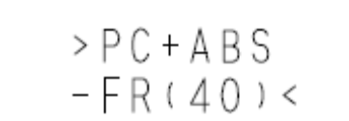
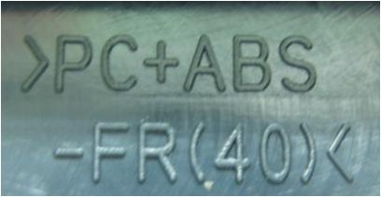
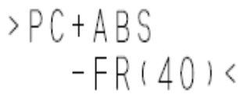
Specific examples.
No. | Drowing | part | judge | Description
1 | >PC+ABS-FR(40)< |  | △ | stamp is wrong “-”OK “+”NG
2 | >PC+ABS-FR(40)< |  | × | stamp is wrong ( don’t have -FR(40))
3 |  |  | ○ | ①2-line position does not match→ no problem ②(40) of () is 〔 〕 is a shape. → there is no problem
4 |  |  | ○ | ① > <. Large characters. → No problem ②2-line position does not match→ no problem －ＦＲ position
>PC+ABS+FR(40)<
PC+ABS

Slide 6
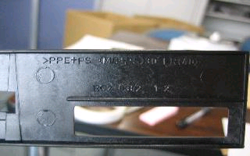
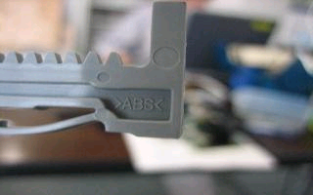
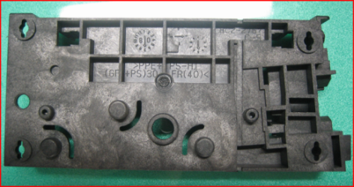
Specific examples
No. | Drowing | part | judge | Description
5 | >PPE+PS-(PS+ZD)30 FR(40)< |  |  | stamp is wrong (PS+ZD)＝OK (MD+PS)＝NG
6 | >PC+ABS-FR(40)< |  | × | stamp is wrong
7 | >PPE+PS-HI(GF+PS)35 FR(40)< |  | △ | stamp is wrong 35＝OK 30＝NG
8 | >PPE+PS- (PS+ZD)30 FR(40)< | >PPE+PS-(PS+ZD)30 FR(40)< | ○ | 2 line drawings. Component is only １ line of text. → there is no problem
>PPE+PS-(MD+PS)30 FR(40)<
×
>ABS<
>PPE+PS-HI(GF+PS)30 FR(40)<

Slide 7
Materials stamp decisions
1.“×”
① Shipped engine. =. Must be reworked
② CVN stock engine. =. Must be reworked
How to Rework: stamp has been deleted. Then re-ink stamp
The modify stamping dies
2. Judge "△" Content
① Ship had to rework the engine is not needed
② CVN stock engines also do not need rework
③ Modified mold die.
Mold die making modifications to ensure customer safety stock
3. Judge “○" Content
No problem
※ If you have any questions,
"Environmental Regulation Division (Japan)" can be contacted

